Slide 1
and it’s applications
Python

Slide 2
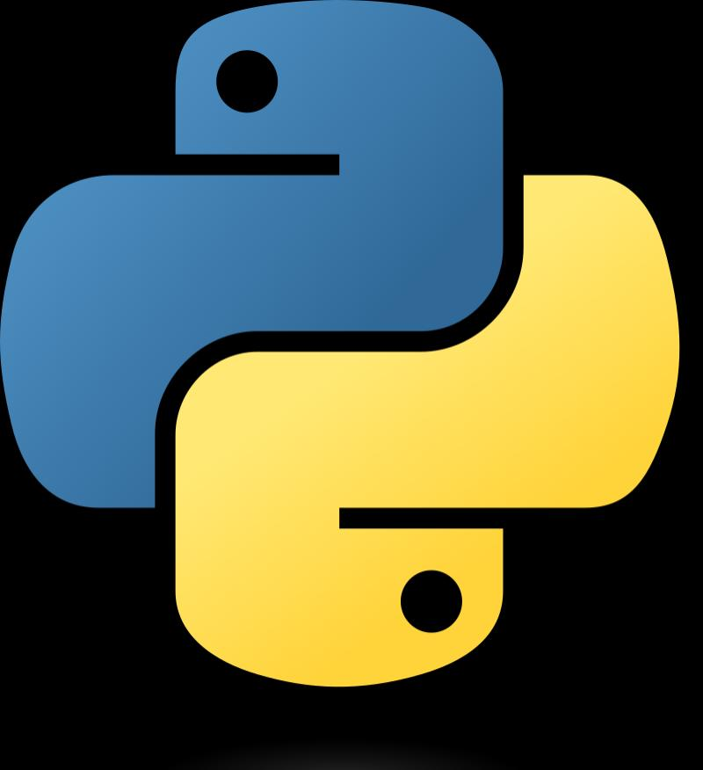
What is python?
Python is a computer programming language often used to build websites and software, automate tasks, and conduct data analysis. Python is a general-purpose language, meaning it can be used to create a variety of different programs and isn't specialized for any specific problems.

Slide 3


Applications
Web applications
We can use Python to develop web applications. It provides libraries to handle internet protocols such as HTML and XML, JSON, Email processing, request, beautifulSoup, Feedparser, etc. One of Python web-framework named Django is used on Instagram. Python provides many useful frameworks, and these are given below: Django and Pyramid framework(Use for heavy applications) Flask and Bottle (Micro-framework) Plone and Django CMS (Advance Content management)

Slide 4
Desktop GUI Applications
The GUI stands for the Graphical User Interface, which provides a smooth interaction to any application. Python provides a Tk GUI library to develop a user interface. Some popular GUI libraries are given below. Tkinter or Tk wxWidgetM Kivy (used for writing multi-touch applications ) PyQt or Pyside

Slide 5
Console based Applications
Console-based applications run from the command-line or shell. These applications are computer program which are used commands to execute. This kind of application was more popular in the old generation of computers. Python can develop this kind of application very effectively. It is famous for having REPL, which means the Read-Eval-Print Loop that makes it the most suitable language for the command-line applications.

Slide 6
Software development
Python is useful for the software development process. It works as a support language and can be used to build control and management, testing, etc. Scons is used to build control. Buildbot and Apache Gumps are used for automated continuous compilation and testing. Round or Trac for bug tracking and project management.

Slide 7
Business applications
Business Applications differ from standard applications. E-commerce and ERP are an example of a business application. This kind of application requires extensively, scalability and readability, and Python provides all these features.
Oddo is an example of the all-in-one Python-based application which offers a range of business applications. Python provides a Tryton platform which is used to develop the business application.

Slide 8
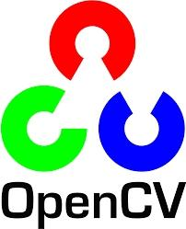
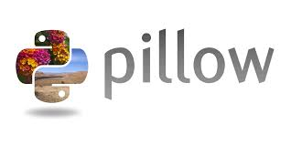
Image processing application
Python contains many libraries that are used to work with the image. The image can be manipulated according to our requirements. Some libraries of image processing are given below.
OpenCV
Pillow
SimpleITK

Slide 9
3D CAD applications
The CAD (Computer-aided design) is used to design engineering related architecture. It is used to develop the 3D representation of a part of a system. Python can create a 3D CAD application by using the following functionalities.
Fandango (Popular )
CAMVOX
HeeksCNC
AnyCAD
RCAM

Slide 10
Presentation made by:-
Somya Pratap Singh
Class:- 12th Science

